Slide 1

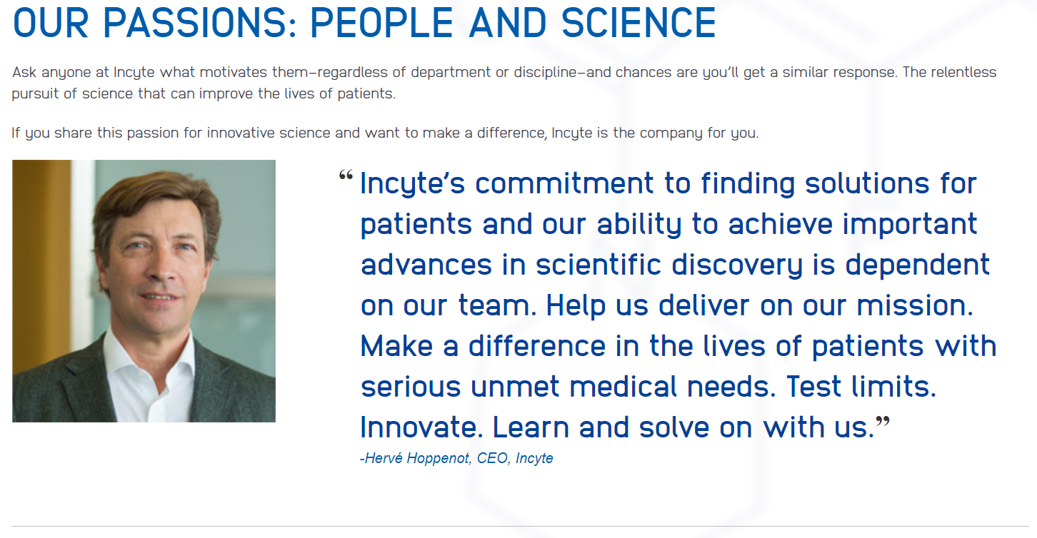

Incyte’s Virtual On-Campus Recruiting Day at UC Irvine
All chemists that are interested in learning about Incyte are invited to attend the Information Session on Monday August 21st at 8 AM PT Room ## or join virtually via Webex (Meeting #2319 711 3461, PW RFxwDv25fX8)
Notes:
Good afternoon

