Slide 1
More basics of DFT
Kieron Burke and friends
UC Irvine Physics and Chemistry

Slide 2
References for ground-state DFT
ABC of DFT, by KB and Rudy Magyar, http://dft.uci.edu
A Primer in Density Functional Theory, edited by C. Fiolhais et al. (Springer-Verlag, NY, 2003)
Density Functional Theory , Dreizler and Gross, (Springer-Verlag, Berlin, 1990)
Density Functional Theory of Atoms and Molecules, Parr and Yang (Oxford, New York, 1989)
A Chemist’s Guide to Density Functional Theory , Koch and Holthausen (Wiley-VCH, Weinheim,2000)

Slide 3
What we’ll cover
Simplest possible example of a functional
Essentials of KS-DFT, and functional zoo
Important conditions not met by standard functionals: Self-interaction and derivative discontinuity
Exact exchange
Quiz

Slide 4
Atomic units and particles in box
In atomic units, all energies are in Hartree (1 H = 27.2 eV) and all distances in Bohr (1 a₀ = 0.529 Å)
To write formulas in atomic units, set e²=Ћ = m_{e}=1
E.g., usual formula for energy levels of infinite well of width L:
Atomic units, box length L=1:

Slide 5


Constructing your very first density functional
Let’s look at the kinetic energy of spinless fermions in 1d:
Is there some way to get T_{s} without evaluating all those damn orbitals? Yes!
Write it as a density functional, i.e., an integral over some function of n(x).
Simplest choice: a local approx:

Slide 6
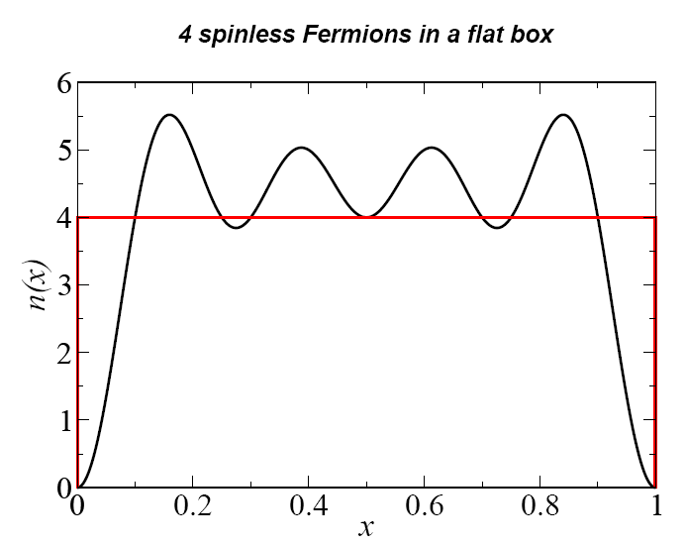
Particles in box
Accuracy
N | T_{s}^{[0]} | T_{s} | %err
1 | 4.112 | 4.934 | -17
2 | 21.79 | 24.67 | -12
3 | 62.92 | 69.09 | -9

Slide 7
What we’ve learned
Density functionals are approximations for the energy of many particles
Work best for large N, worst for small N
Local approximations are crudely correct, but miss details

Slide 8
Essence of Kohn-Sham DFT
Even with exact E_{xc}[n], only get E₀ and n(r) (and I). So other properties may not be right.
Results only as good as functional used.
Vast amount of information from E₀ alone, such as geometries, vibrations, bond energies…
Well-fitted functionals are accurate for limited set
Non-empirical functionals less so, but more reliable for a broader range, and errors understandable

Slide 9
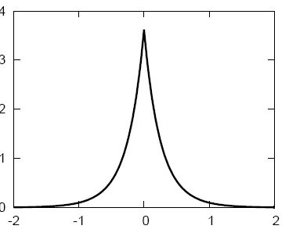
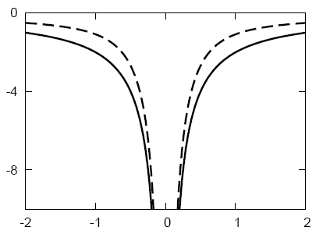
He atom in Kohn-Sham DFT
Everything has (at most) one KS potential
Dashed-line:
EXACT KS potential

Slide 10
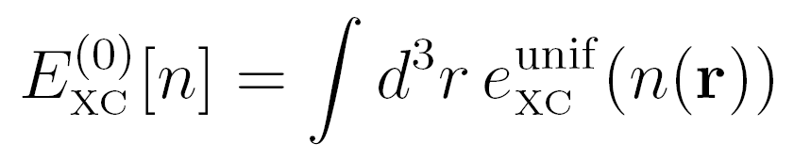
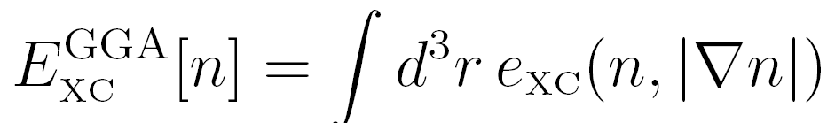
Functionals in common use
Local density approximation (LDA)
Uses only n(r) at a point.
Generalized gradient approx (GGA)
Uses both n(r) and |∇n(r)|
More accurate, corrects overbinding of LDA
Examples are PBE and BLYP
Hybrid:
Mixes some fraction of HF
Examples are B3LYP and PBE0

Slide 11
Functional soup
Good: choose one functional of each kind and stick with it (e.g., LDA or PBE or B3LYP).
Bad: Run several functionals, and pick ‘best’ answer.
Ugly: Design your own functional with 2300 parameters.

Slide 12
Functional Zoology
Empirical
GGA: BLYP
Hybrid:B3LYP
Names:
B=B88 exchange
LYP=Lee-Yang-Parr corelation
Non-empirical
GGA: PBE
Meta-GGA: TPSS
Hybrid:PBE0

Slide 13
What we’ll cover
Simplest possible example of a functional
Essentials of KS-DFT, and functional zoo
Important conditions not met by standard functionals: Self-interaction and derivative discontinuity
Exact exchange
Quiz

Slide 14
What we’ll cover
Simplest possible example of a functional
Essentials of KS-DFT, and functional zoo
Important conditions not met by standard functionals: Self-interaction and derivative discontinuity
Exact exchange
Quiz

Slide 15
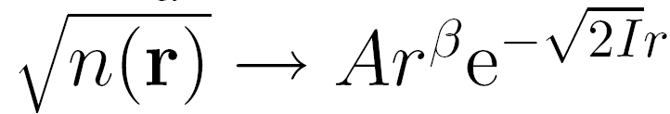


Simple conditions for Coulomb systems
Asymptotic decay of the density
Leads to severe constraint on KS potential
And determines KS HOMO:

Slide 16
KS potential for He atom

Slide 17
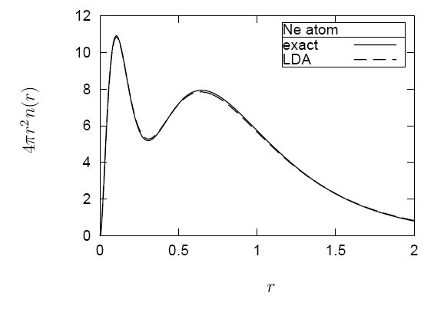
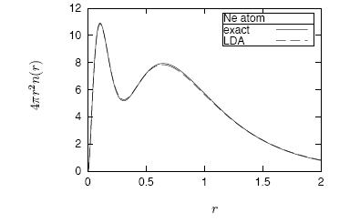
Densities

Slide 18
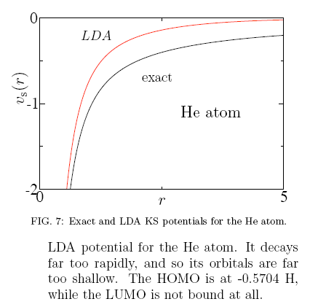
LDA potential

Slide 19
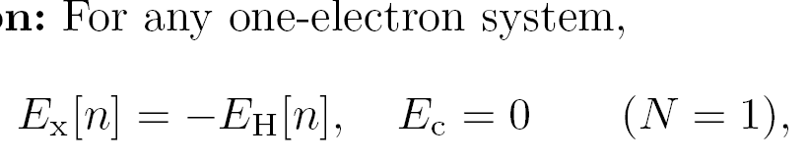
Self interaction
Violated by most semilocal functionals (unless built in)

Slide 20
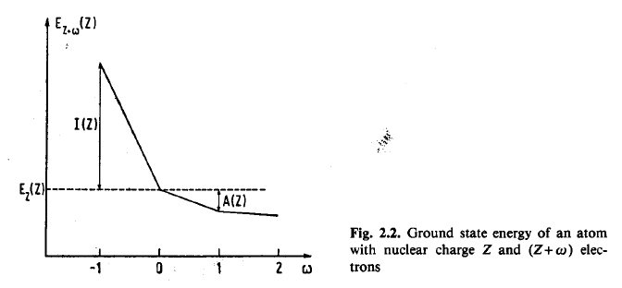
Energy as function of N
From Dreizler + Gross

Slide 21
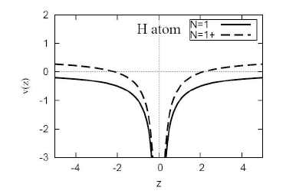
Derivative discontinuity
When you add a tiny fraction of an electron to a system, the KS potential shifts uniformly, since before, ε_{HOMO} (N)=-I, but now, ε_{HOMO} (N+δ)=-A
Thus v_{s}(r) must jump by Δ_{xc}=(I-A)- (ε_{HOMO-}ε_{LUMO})

Slide 22
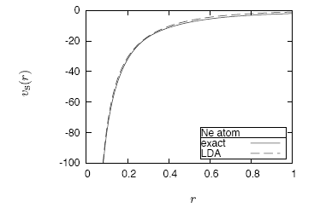
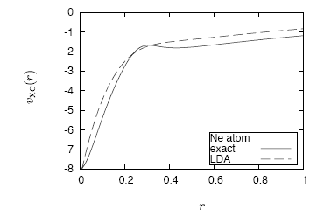
Ne Potentials

Slide 23
Missing derivative discontinuity in LDA
LDA looks like exact, shifted by about I/2

Slide 24
What we’ll cover
Simplest possible example of a functional
Essentials of KS-DFT, and functional zoo
Important conditions not met by standard functionals: Self-interaction and derivative discontinuity
Exact exchange
Quiz

Slide 25
What we’ll cover
Simplest possible example of a functional
Essentials of KS-DFT, and functional zoo
Important conditions not met by standard functionals: Self-interaction and derivative discontinuity
Exact exchange
Quiz

Slide 26
What ever happened to HF?
We know E_{x} is just
So why can’t we just put that in KS equations?
Because don’t know E_{x}[n], so must approximate

Slide 27
OEP
See RMP , Kuemmel and Kronik
Way to handle orbital-dependent functionals in KS scheme, i.e., with single multiplicative KS potential
Still density functionals, since orbitals uniquely determined by density
Often called OPM
Several schemes to implement, all much more expensive than regular KS-DFT
Can improve other properties:
No self-interaction error
Potentials and orbital energies much better
Approximates derivative discontinuity

Slide 28
HF versus EXX
HF minimizes E_{x} [{φ_{i}}] over all possible wavefunctions
EXX includes additional constraint of common potential (i.e., KS)
Yield almost identical total energies, with HF an eensty bit lower.
Occupied orbital energies very similar, but big difference in unoccupied orbitals

Slide 29
A tale of three gaps
Fundamental gap:
Δ = I – A =24.6eV for He
Kohn-Sham gap:
Δ_{s} = ε_{HOMO}-ε_{LUMO} = 21.16 eV
Derivative discontinuity: Δ_{xc}= Δ-Δ_{s}
Lowest optical transition:
ω_{min}= E(1s,2p)-E(1s²) = 21.22eV
NOTE: All same if non-interacting, all different when interacting
Of course, ε_{HOMO}(LDA)=15.5 eV

Slide 30
Quiz
Do local functionals do better for:
A. small N, B. large N ?
How many empirical parameters are too many?
A. 1; B. 10., C. 100+
GGA’s have no self-interaction error,
True or false?
The Kohn-Sham gap would equal the true gap if only we had the exact functional?
Why not use E_{x} in small calculations to improve geometries, etc.?

Slide 31
What we’ve learned, maybe
Ground-state density determines all properties of system, in principle, but in practice, only really get energy and density (which is 90% of what you want).
Local density functional theories give roughly correct answers, but are too inaccurate to be helpful in quantum chemistry.
The commonly-used functionals in chemistry are well-founded and have few parameters.
There are known exact properties of the density in real atoms.
There are subtle and bizarre effects in the KS potential because real electrons do interact.
Exact exchange is expensive, and we don’t have a correlation functional to go with it, but it improves some properties.

