Slide 1
MO Diagrams for
Linear and Bent Molecules
Chapter 5
Monday, October 12, 2015

Slide 2
Molecular Orbitals for Larger Molecules
1. Determine point group of molecule (if linear, use D_{2h} and C_{2v} instead of D_{∞h} or C_{∞v})
2. Assign x, y, z coordinates
(z axis is principal axis; if non-linear, y axes of outer atoms point to central atom)
3. Find the characters of the reducible representation for the combination of
valence orbitals on the outer atoms. Treat s, p_{x}, p_{y}, p_{z}, etc. separately (as for
vibrations, orbitals that change position = 0, orbitals that do not change = 1; and
orbitals that remain in the same position but change sign = -1)
4. Find the irreducible representations (they correspond to the symmetry of group
orbitals, also called Symmetry Adapted Linear Combinations, SALCs of the orbitals)
5. Find AOs on central atom with the same symmetry
6. Combine AOs from central atom with those group orbitals of same symmetry
and similar energy to make the MO diagram

Slide 3
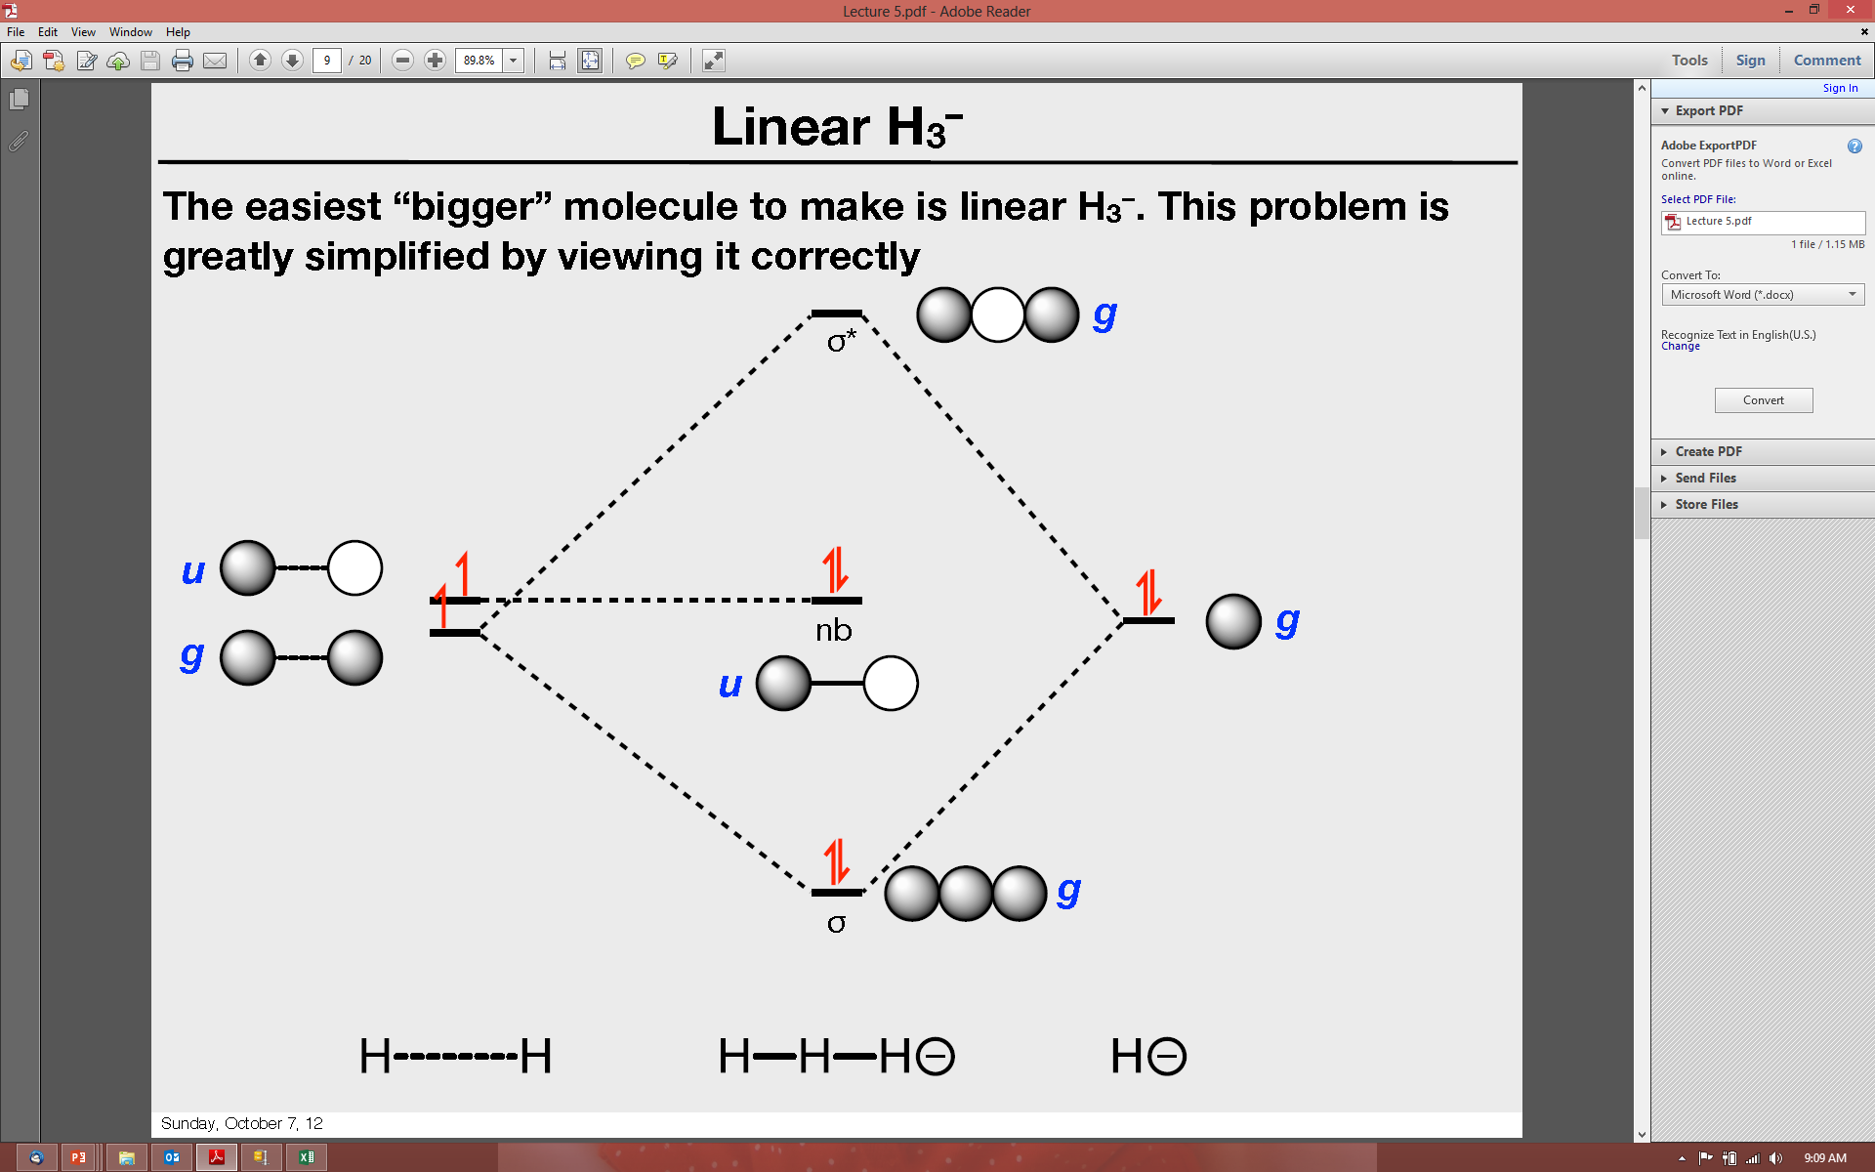
Linear H3⁺ by Inspection
Among the easiest multi-atom molecules to build is linear H₃⁺.
General procedure for simple molecules that contain a central atom:
build group orbitals using the outer atoms, then interact the group orbitals with the central atom orbitals to make the MOs.
Only group orbitals and central atom orbitals with the same symmetry and similar energy will interact.
+
H–H–H
H · H + H⁺
group of outer atoms
central atom
u
g
group
orbitals
g

Slide 4
Linear H3⁺
g orbitals interact, while u orbital is nonbonding.
g
σ*
u
g
u
nb
g
3-center, 2-electron bond!
g
σ
+
H⁺
H–H–H
H · H

Slide 5

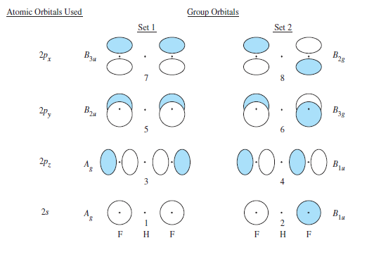
Linear FHF⁻ by Inspection
In building the group orbitals for FHF⁻, we must consider the 2s and 2p orbitals of the two fluorines (8 AOs in total). Use point group D_{2h}.
-
F–H–F
F · F + H⁻
group of outer atoms
central atom
A_{g}
2p_{x}
B_{3u}
B_{2g}
2p_{y}
B_{2u}
B_{3g}
group
orbitals
2p_{z}
A_{g}
B_{1u}
A_{g}
2s
B_{1u}

Slide 6
Linear FHF⁻
In building the group orbitals for FHF⁻, we must consider the 2s and 2p orbitals of the two fluorines (8 AOs in total). Use point group D_{2h}.
-
F–H–F
F · F + H⁻
group of outer atoms
central atom
A_{g}
2p_{x}
B_{3u}
B_{2g}
2p_{y}
B_{2u}
B_{3g}
group
orbitals
2p_{z}
A_{g}
B_{1u}
A_{g}
2s
B_{1u}

Slide 7
Linear FHF⁻
In building the group orbitals for FHF⁻, we must consider the 2s and 2p orbitals of the two fluorines (8 AOs in total). Use point group D_{2h}.
-
F–H–F
F · F + H⁻
group of outer atoms
central atom
A_{g}
2p_{x}
B_{3u}
B_{2g}
2p_{y}
B_{2u}
B_{3g}
The central atom has proper symmetry to interact only with group orbitals 1 and 3.
group
orbitals
2p_{z}
A_{g}
B_{1u}
A_{g}
2s
B_{1u}

Slide 8
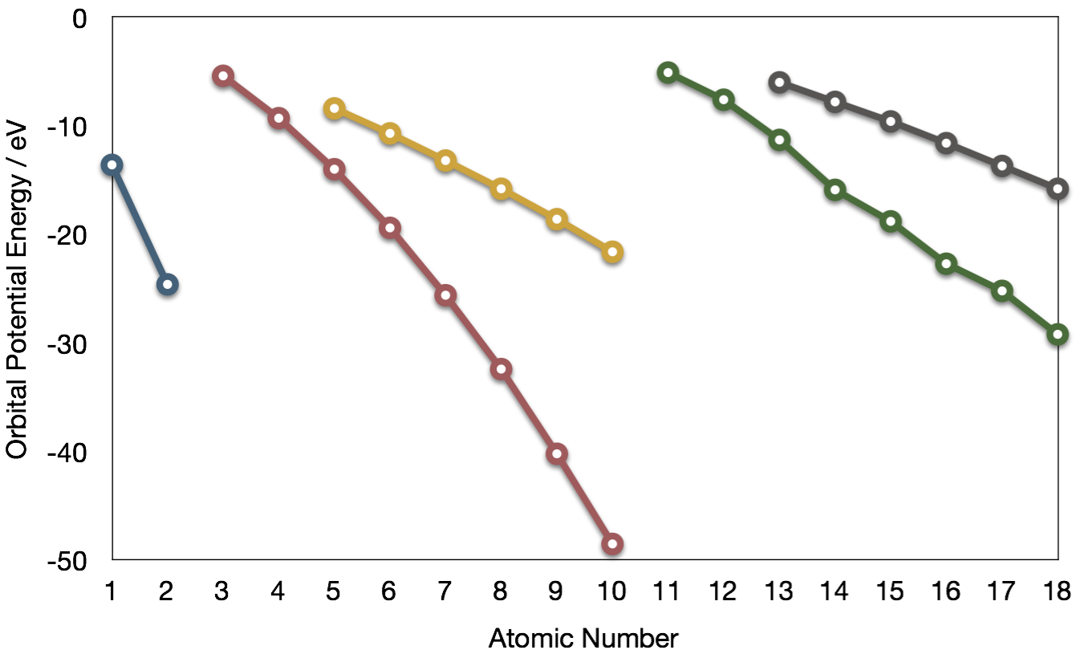
Relative AO Energies for MO Diagrams
F 2s orbital is very deep in energy and will be essentially nonbonding.
Al
B
Si
Li
C
Na
P
Mg
S
H
Be
N
3p
Cl
–13.6 eV
Al
Ar
B
O
3s
2p
F
Si
1s
–18.6 eV
C
2s
Ne
P
He
S
N
Cl
Ar
O
F
–40.2 eV
Ne

Slide 9
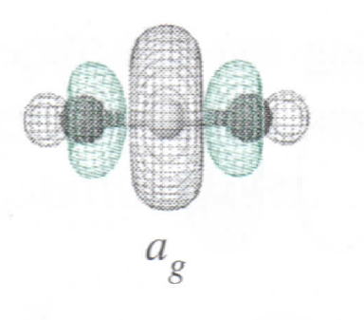
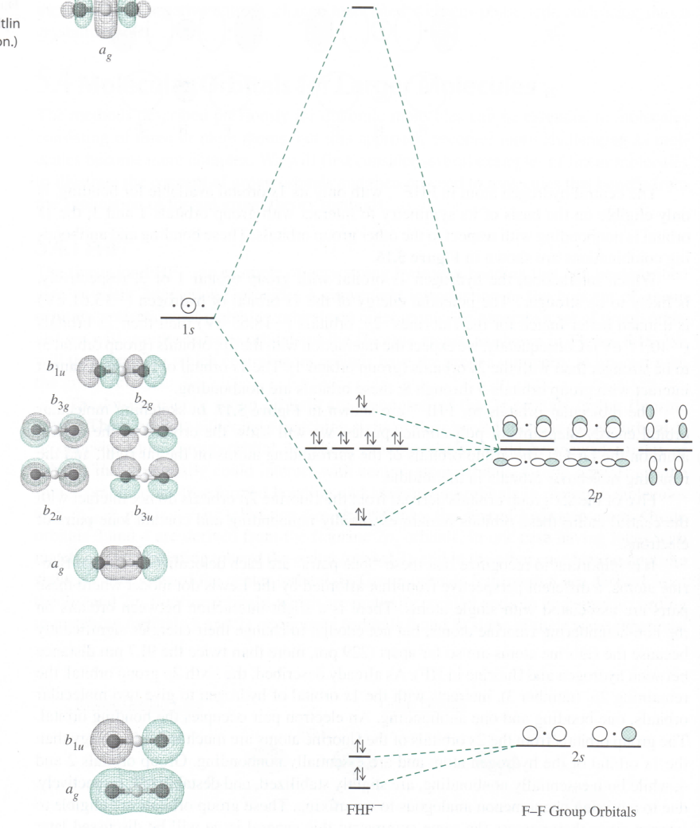
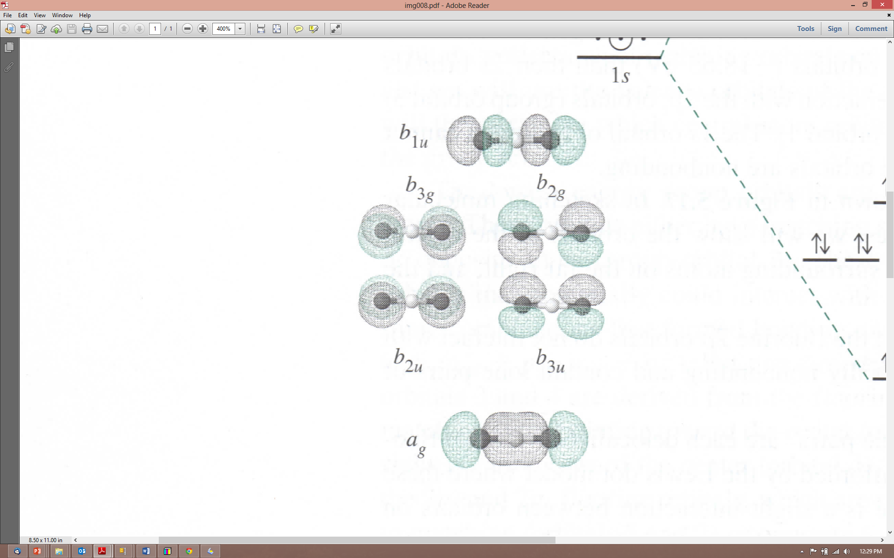
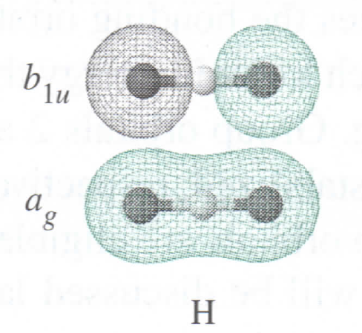
Linear FHF⁻
F 2s orbitals are too deep in energy to interact, leaving an interaction (σ) only with group orbital 3. Some sp mixing occurs between a_{g} and b_{1u} MOs.
The two fluorines are too far apart to interact directly (S very small).
nonbonding
Lewis:
:
:
:F:H:F:
bond
:
:
nb
very weak bond
MO:
<2 bonds, >6 lone pairs

Slide 10
Carbon Dioxide by Inspection
CO₂ is also linear. Here all three atoms have 2s and 2p orbitals to consider. Again, use point group D_{2h} instead of D_{∞h}.
O=C=O
O · O + C
group of outer atoms
central atom
A_{g}
B_{1u}
2p_{x}
B_{2g}
B_{3u}
B_{3u}
B_{2u}
2p_{y}
B_{3g}
B_{2u}
group
orbitals
same as
F- -F
2p_{z}
B_{1u}
A_{g}
carbon has four AOs to consider!
A_{g}
B_{1u}
2s

Slide 11
Relative AO Energies in MO Diagrams
Use AO energies to draw MO diagram to scale (more or less).
Al
B
Si
Li
C
Na
P
–10.7 eV
Mg
S
H
Be
N
3p
Cl
Al
Ar
B
O
–15.8 eV
3s
2p
F
Si
1s
–19.4 eV
C
2s
Ne
P
He
S
N
Cl
Ar
–32.4 eV
O
F
Ne

Slide 12
Carbon Dioxide
4b_{1u}
–10.7 eV
4a_{g}
B_{1u}
B_{2g}
B_{3g}
B_{2u}
B_{3u}
B_{1u}
–15.8 eV
B_{2u}
B_{3u}
–19.4 eV
3b_{1u}
A_{g}
A_{g}
3a_{g}
B_{1u}
2b_{1u}
–32.4 eV
A_{g}
2a_{g}
C
O=C=O
O · O

Slide 13
Carbon Dioxide
4b_{1u}
2b_{2u}
2b_{3u}
–10.7 eV
4a_{g}
B_{1u}
B_{2g}
B_{3g}
B_{2u}
B_{3u}
B_{1u}
1b_{2g}
1b_{3g}
–15.8 eV
1b_{2u}
1b_{3u}
B_{2u}
B_{3u}
–19.4 eV
3b_{1u}
A_{g}
A_{g}
3a_{g}
B_{1u}
2b_{1u}
–32.4 eV
A_{g}
2a_{g}
C
O=C=O
O · O

Slide 14
Carbon Dioxide
–10.7 eV
–15.8 eV
two π bonds
–19.4 eV
two σ bonds
four lone pairs centered on oxygen
–32.4 eV
C
O=C=O
O · O

Slide 15
Molecular Orbitals for Larger Molecules
To this point we’ve built the group orbitals by inspection. For more complicated molecules, it is better to use the procedure given earlier:
1. Determine point group of molecule (if linear, use D_{2h} and C_{2v} instead of D_{∞h} or C_{∞v})
2. Assign x, y, z coordinates
(z axis is principal axis; if non-linear, y axes of outer atoms point to central atom)
3. Find the characters of the reducible representation for the combination of
valence orbitals on the outer atoms. Treat s, p_{x}, p_{y}, p_{z}, etc. separately (as for
vibrations, orbitals that change position = 0, orbitals that do not change = 1; and
orbitals that remain in the same position but change sign = -1)
4. Find the irreducible representations (they correspond to the symmetry of group
orbitals, also called Symmetry Adapted Linear Combinations, SALCs of the orbitals)
5. Find AOs on central atom with the same symmetry
6. Combine AOs from central atom with those group orbitals of same symmetry
and similar energy

Slide 16
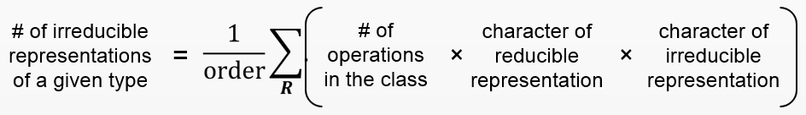
Carbon Dioxide by Reducible Representations
1. Use point group D_{2h} instead of D_{∞h} (this is called descending in symmetry).
2.
Γ_{2s} | 2 | 2 | 0 | 0 | 0 | 0 | 2 | 2
Γ_{2pz} | 2 | 2 | 0 | 0 | 0 | 0 | 2 | 2
Γ_{2px} | 2 | -2 | 0 | 0 | 0 | 0 | 2 | -2
Γ_{2py} | 2 | -2 | 0 | 0 | 0 | 0 | -2 | 2
3. Make reducible reps for outer atoms
4. Get group orbital symmetries by reducing each Γ
Γ_{2s} = A_{g} + B_{1u}
Γ_{2px} = B_{2g} + B_{3u}
Γ_{2pz} = A_{g} + B_{1u}
Γ_{2py} = B_{3g} + B_{2u}

Slide 17
Carbon Dioxide by Reducible Representations
Γ_{2s} = A_{g} + B_{1u}
Γ_{2px} = B_{2g} + B_{3u}
Γ_{2pz} = A_{g} + B_{1u}
Γ_{2py} = B_{3g} + B_{2u}
These are the same group orbital symmetries that we got using inspection. We can (re)draw them.
2p_{x}
B_{2g}
B_{3u}
2p_{y}
B_{3g}
B_{2u}
2p_{z}
B_{1u}
A_{g}
A_{g}
B_{1u}
2s
6. Build MO
diagram…
5. Find matching orbitals on central atom
A_{g}
B_{1u}
B_{3u}
B_{2u}

Slide 18
Carbon Dioxide
–10.7 eV
–15.8 eV
–19.4 eV
–32.4 eV
C
O=C=O
O · O

Slide 19
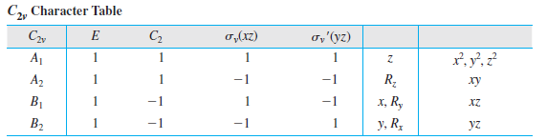
Water
1. Point group C_{2v}
2.
3. Make reducible reps for outer atoms
Γ_{1s} | 2 | 0 | 2 | 0
4. Get group orbital symmetries by reducing Γ
Γ_{1s} = A₁ + B₁

Slide 20
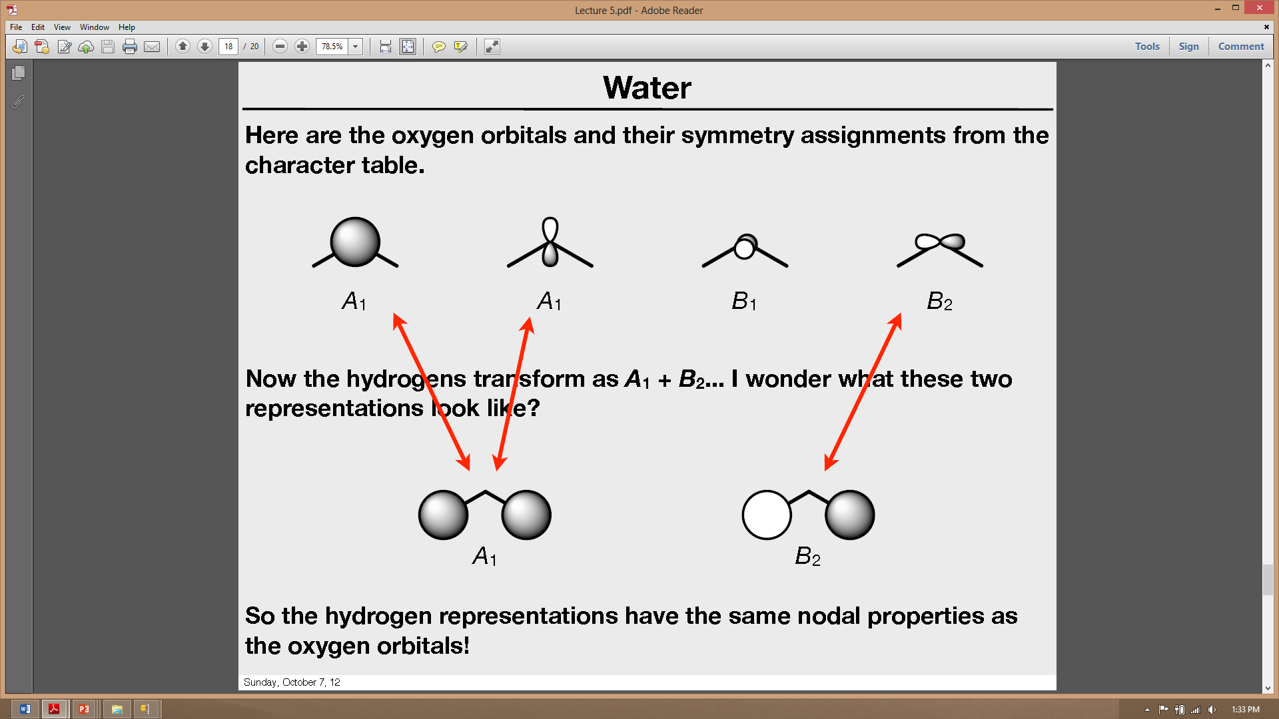
Water
Γ_{1s} = A₁ + B₁
The hydrogen group orbitals look like:
A₁
B₁
5. Find matching orbitals on central O atom
A₁
A₁
B₁
B₂
6. Build MO diagram. We expect six MOs, with the O 2p_{y} totally nonbonding.

Slide 21
Water
Based on the large ΔE, we expect O 2s to be almost nonbonding.
Al
B
Si
Li
C
Na
P
Mg
S
H
Be
N
3p
Cl
Al
Ar
–13.6 eV
O
–15.8 eV
3s
B
2p
F
Si
1s
C
2s
Ne
P
He
S
N
Cl
Ar
–32.4 eV
O
F
Ne

Slide 22


Water
With the orbital shapes, symmetries, and energies in hand we can make the MO diagram!
2b1
B1
A1
4a1
–13.6 eV
A1
nb
–15.8 eV
1b2
B1
B2
σ
3a1
Two bonds, two lone pairs on O. HOMO is nonbonding.
σ
1b1
nb
–32.4 eV
A1
2a1

