Slide 1
MO Diagrams for
More Complex Molecules
Chapter 5
Wednesday, October 14, 2015

Slide 2
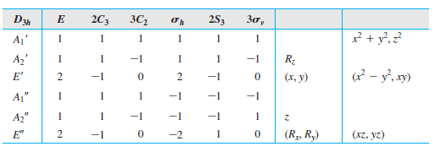
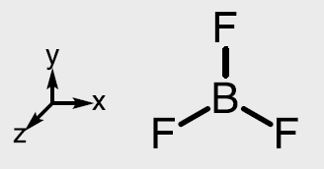
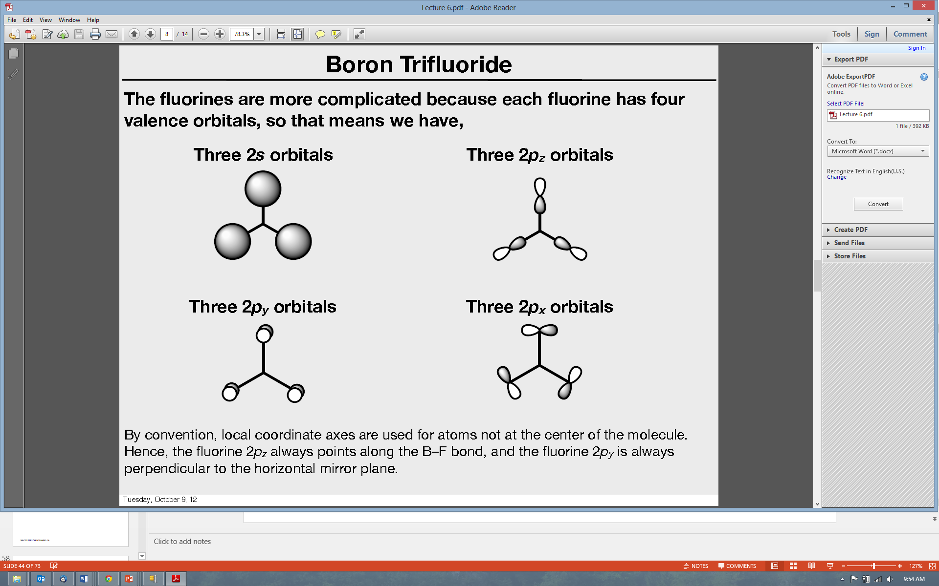
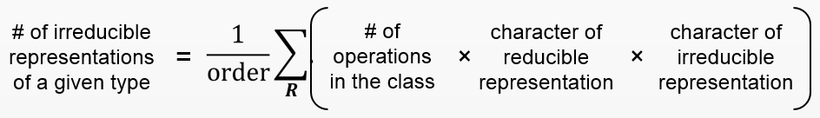
Boron trifluoride
1. Point group D_{3h}
3. Make reducible reps for outer atoms
2.
z
x
x
y
y
z
y
z
x
Γ_{2s} | 3 | 0 | 1 | 3 | 0 | 1
Γ_{2pz} | 3 | 0 | -1 | -3 | 0 | 1
Γ_{2px} | 3 | 0 | -1 | 3 | 0 | -1
Γ_{2py} | 3 | 0 | 1 | 3 | 0 | 1
4. Get group orbital symmetries by reducing each Γ
Γ_{2s} = A₁’ + E’
Γ_{2px} = A₂’ + E’
Γ_{2pz} = A₂’’ + E’’
Γ_{2py} = A₁’ + E’

Slide 3
Boron trifluoride
Γ_{2s} = A₁’ + E’
Γ_{2px} = A₂’ + E’
Γ_{2pz} = A₂’’ + E’’
Γ_{2py} = A₁’ + E’
What is the shape of the group orbitals?
2s:
?
?
A₁’
E’(y)
E’(x)
Which combinations of the three AOs are correct?
The projection operator method provides a systematic way to find how the AOs should be combined to give the right group orbitals (SALCs).

Slide 4
BF₃ - Projection Operator Method
In the projection operator method, we pick one AO in each set of identical AOs and determine how it transforms under each symmetry operation of the point group.
F_{a}
AO | E | C₃ | C₃² | C_{2(a)} | C_{2(b)} | C_{2(c)} | σ_{h} | S₃ | S₃² | σ_{v(a)} | σ_{v(b)} | σ_{v(c)}
F_{a} | F_{a} | F_{b} | F_{c} | F_{a} | F_{c} | F_{b} | F_{a} | F_{b} | F_{c} | F_{a} | F_{c} | F_{b}
F_{b}
F_{c}
A₁’ | 1 | 1 | 1 | 1 | 1 | 1 | 1 | 1 | 1 | 1 | 1 | 1
A₁’ = F_{a} + F_{b} + F_{c} + F_{a} + F_{c} + F_{b} + F_{a} + F_{b} + F_{c} + F_{a} + F_{c} + F_{b}
A₁’ = 4F_{a} + 4F_{b} + 4F_{c}
A₁’
The group orbital wavefunctions are determined by multiplying the projection table values by the characters of each irreducible representation and summing the results.

Slide 5
BF₃ - Projection Operator Method
In the projection operator method, we pick one AO in each set of identical AOs and determine how it transforms under each symmetry operation of the point group.
F_{a}
AO | E | C₃ | C₃² | C_{2(a)} | C_{2(b)} | C_{2(c)} | σ_{h} | S₃ | S₃² | σ_{v(a)} | σ_{v(b)} | σ_{v(c)}
F_{a} | F_{a} | F_{b} | F_{c} | F_{a} | F_{c} | F_{b} | F_{a} | F_{b} | F_{c} | F_{a} | F_{c} | F_{b}
F_{b}
F_{c}
A₂’ | 1 | 1 | 1 | -1 | -1 | -1 | 1 | 1 | 1 | -1 | -1 | -1
A₂’ = F_{a} + F_{b} + F_{c} – F_{a} – F_{c} – F_{b} + F_{a} + F_{b} + F_{c} – F_{a} – F_{c} – F_{b}
A₂’ = 0
There is no A₂’ group orbital!
The group orbital wavefunctions are determined by multiplying the projection table values by the characters of each irreducible representation and summing the results.

Slide 6
BF₃ - Projection Operator Method
In the projection operator method, we pick one AO in each set of identical AOs and determine how it transforms under each symmetry operation of the point group.
F_{a}
AO | E | C₃ | C₃² | C_{2(a)} | C_{2(b)} | C_{2(c)} | σ_{h} | S₃ | S₃² | σ_{v(a)} | σ_{v(b)} | σ_{v(c)}
F_{a} | F_{a} | F_{b} | F_{c} | F_{a} | F_{c} | F_{b} | F_{a} | F_{b} | F_{c} | F_{a} | F_{c} | F_{b}
F_{b}
F_{c}
E’ | 2 | -1 | -1 | 0 | 0 | 0 | 2 | -1 | -1 | 0 | 0 | 0
E’ = 2F_{a} – F_{b} – F_{c} + 0 + 0 + 0 + 2F_{a} – F_{b} – F_{c} + 0 + 0 + 0
E’ = 4F_{a} – 2F_{b} – 2F_{c}
E’(y)
The group orbital wavefunctions are determined by multiplying the projection table values by the characters of each irreducible representation and summing the results.

Slide 7
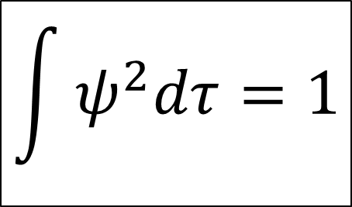
BF₃ - Projection Operator Method
Γ_{2s} = A₁’ + E’
Γ_{2px} = A₂’ + E’
Γ_{2pz} = A₂’’ + E’’
Γ_{2py} = A₁’ + E’
What is the shape of the group orbitals?
2s:
?
?
A₁’
E’(y)
E’(x)
We can get the third group orbital, E’(x), by using normalization.
$$\int{ψ^{2}dτ=1}$$
Normalization condition

Slide 8
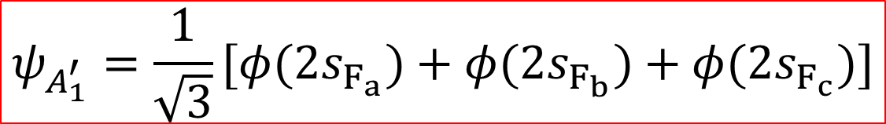
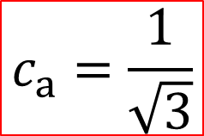
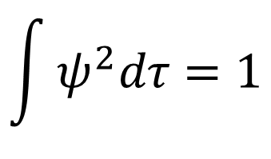

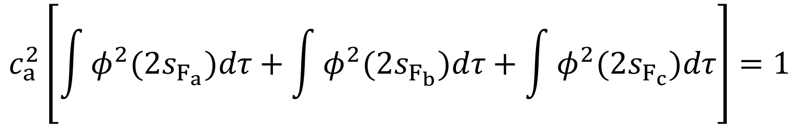
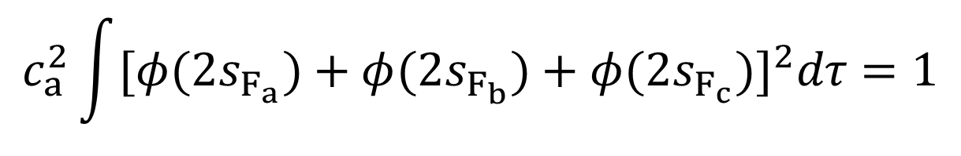
BF₃ - Projection Operator Method
Let’s normalize the A₁’ group orbital:
$$ψ_{A_{1}^{′}}={c_{a}[φ(2s}_{F_{a}})+{φ(2s}_{F_{b}})+{φ(2s}_{F_{c}})]$$
A₁’ wavefunction
$$\int{ψ^{2}dτ=1}$$
Normalization condition for group orbitals
$$c_{a}^{2}\int{{[φ(2s}_{F_{a}})+{φ(2s}_{F_{b}})+{φ(2s}_{F_{c}})]^{2}dτ=1}$$
nine terms, but the six overlap (S) terms are zero.
$$c_{a}^{2}\left[\int{{φ^{2}(2s}_{F_{a}})dτ+\int{{φ^{2}(2s}_{F_{b}})dτ}+\int{{φ^{2}(2s}_{F_{c}})dτ}}\right]=1$$
$$c_{a}=\frac{1}{\sqrt{3}}$$
$$c_{a}^{2}\left[1+1+1\right]=1$$
$$ψ_{A_{1}^{′}}={\frac{1}{\sqrt{3}}[φ(2s}_{F_{a}})+{φ(2s}_{F_{b}})+{φ(2s}_{F_{c}})]$$
So the normalized A₁’ GO is:

Slide 9
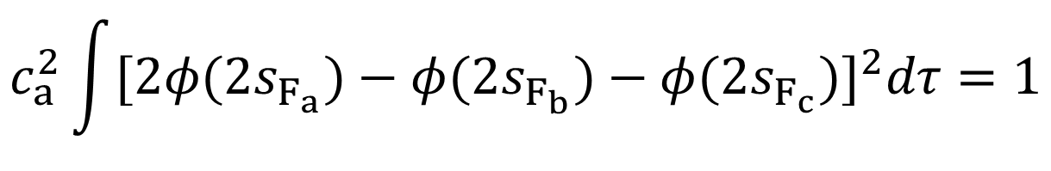
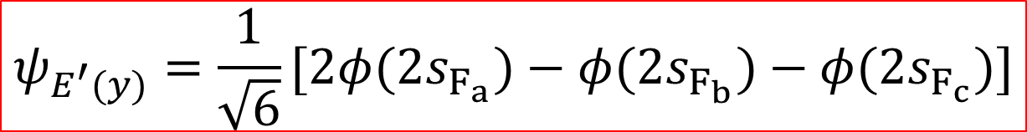


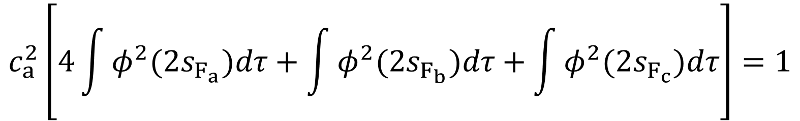
BF₃ - Projection Operator Method
Now let’s normalize the E’(y) group orbital:
$$ψ_{E^{′}(y)}={c_{a}[2φ(2s}_{F_{a}})−{φ(2s}_{F_{b}})−{φ(2s}_{F_{c}})]$$
E’(y) wavefunction
$$c_{a}^{2}\int{{[2φ(2s}_{F_{a}})−{φ(2s}_{F_{b}})−{φ(2s}_{F_{c}})]^{2}dτ=1}$$
nine terms, but the six overlap (S) terms are zero.
$$c_{a}^{2}\left[4\int{{φ^{2}(2s}_{F_{a}})dτ+\int{{φ^{2}(2s}_{F_{b}})dτ}+\int{{φ^{2}(2s}_{F_{c}})dτ}}\right]=1$$
$$c_{a}=\frac{1}{\sqrt{6}}$$
$$c_{a}^{2}\left[4+1+1\right]=1$$
$$ψ_{E^{′}(y)}={\frac{1}{\sqrt{6}}[2φ(2s}_{F_{a}})−{φ(2s}_{F_{b}})−{φ(2s}_{F_{c}})]$$
So the normalized E’(y) GO is:

Slide 10

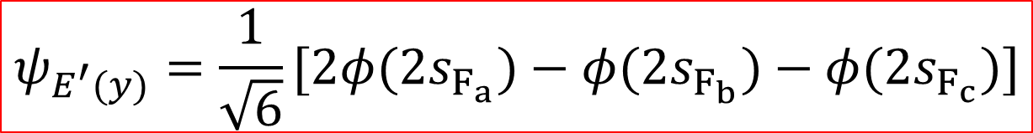
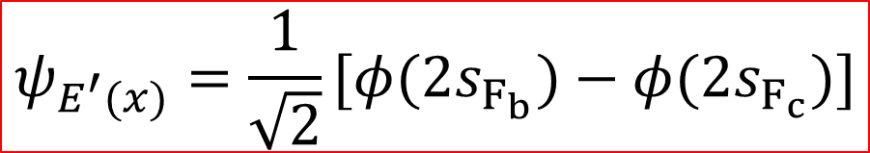
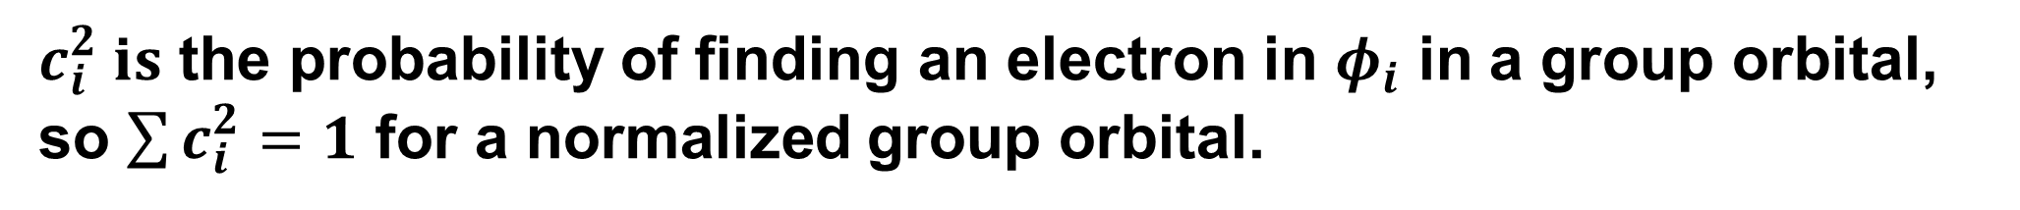
BF₃ - Projection Operator Method
$$ψ_{A_{1}^{′}}={\frac{1}{\sqrt{3}}[φ(2s}_{F_{a}})+{φ(2s}_{F_{b}})+{φ(2s}_{F_{c}})]$$
$$ψ_{E^{′}(y)}={\frac{1}{\sqrt{6}}[2φ(2s}_{F_{a}})−{φ(2s}_{F_{b}})−{φ(2s}_{F_{c}})]$$
$c_{i}^{2} is$ the probability of finding an electron in $φ_{i}$ in a group orbital, so $\sum{c_{i}^{2}=1}$ for a normalized group orbital.
$$ψ_{E^{′}(x)}=\frac{1}{\sqrt{2}}[{φ(2s}_{F_{b}})−{φ(2s}_{F_{c}})]$$
So the normalized E’(x) GO is:

Slide 11
BF₃ - Projection Operator Method
Γ_{2s} = A₁’ + E’
Γ_{2px} = A₂’ + E’
Γ_{2pz} = A₂’’ + E’’
Γ_{2py} = A₁’ + E’
What is the shape of the group orbitals?
notice the GOs are orthogonal (S = 0).
2s:
?
A₁’
E’(y)
E’(x)
Now we have the symmetries and wavefunctions of the 2s GOs.
We could do the same analysis to get the GOs for the p_{x}, p_{y}, and p_{z} orbitals (see next slide).

