Slide 1
MO Diagrams for
More Complex Molecules
Chapter 5
Friday, October 16, 2015

Slide 2
BF₃ - Projection Operator Method
boron orbitals
2s:
A₁’
E’(y)
E’(x)
A₁’
2p_{y}:
E’(y)
A₁’
E’(y)
E’(x)
E’(x)
2p_{x}:
A₂’
E’(y)
E’(x)
A₂’’
2p_{z}:
A₂’’
E’’(y)
E’’(x)

Slide 3
BF₃ - Projection Operator Method
boron orbitals
2s:
A₁’
E’(y)
E’(x)
A₁’
2p_{y}:
E’(y)
A₁’
E’(y)
E’(x)
little overlap
E’(x)
2p_{x}:
A₂’
E’(y)
E’(x)
A₂’’
2p_{z}:
A₂’’
E’’(y)
E’’(x)

Slide 4
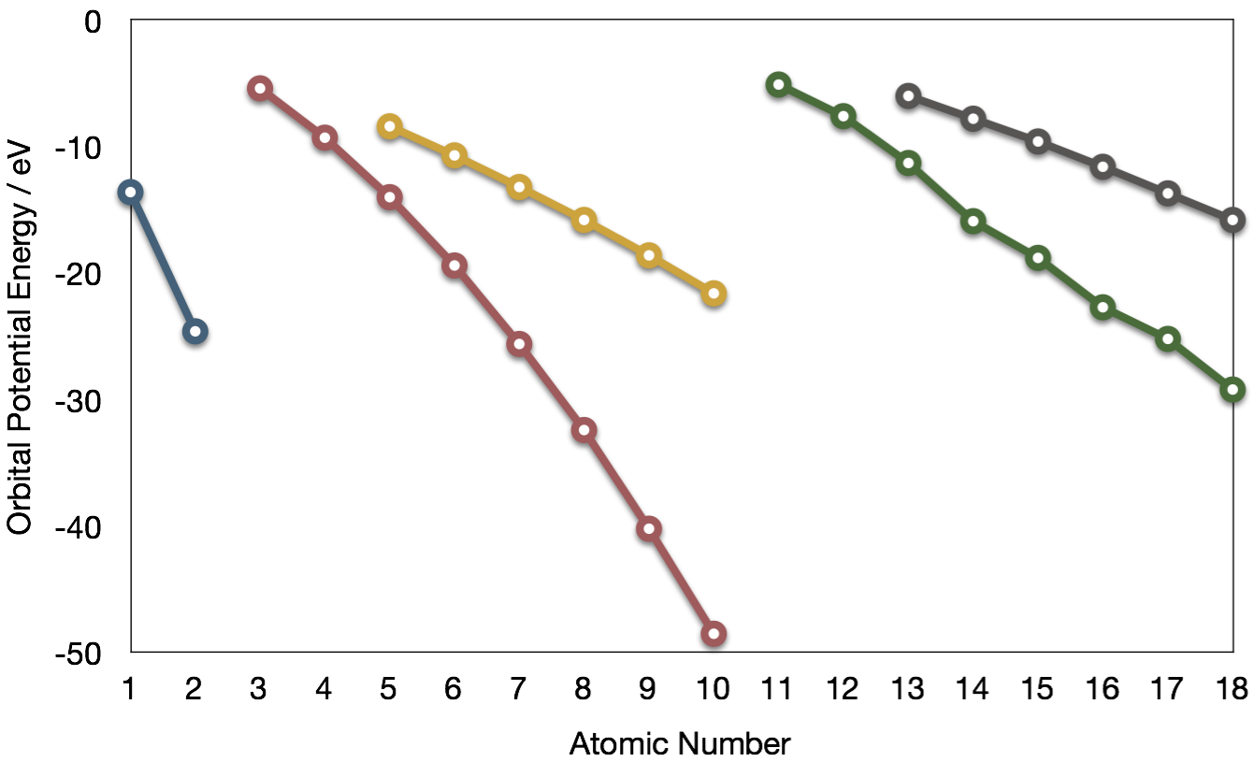
Boron trifluoride
F 2s is very deep in energy and won’t interact with boron.
Al
B
–8.3 eV
Si
Li
C
Na
P
Mg
S
H
Be
N
3p
Cl
Al
Ar
–14.0 eV
B
O
3s
2p
F
–18.6 eV
Si
1s
C
2s
Ne
P
He
S
N
Cl
Ar
O
–40.2 eV
F
Ne

Slide 5












Boron Trifluoride
σ*
E′
σ*
π*
–8.3 eV
a₂″
A2″
–14.0 eV
Energy
A1′
A2′ + E′
nb
A2″ + E″
–18.6 eV
A1′ + E′
π
a₂″
σ
σ
e′
a₁′
A1′ + E′
–40.2 eV
nb

Slide 6
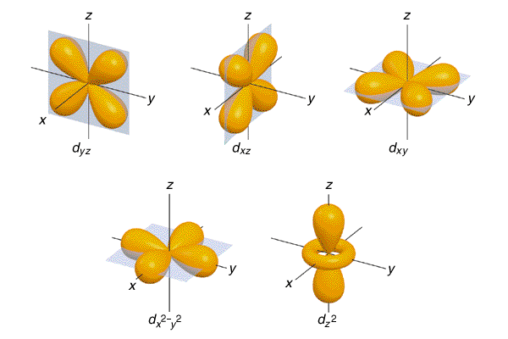
d orbitals
l = 2, so there are 2l + 1 = 5 d-orbitals per shell, enough room
for 10 electrons.
This is why there are 10 elements in each row of the d-block.

Slide 7
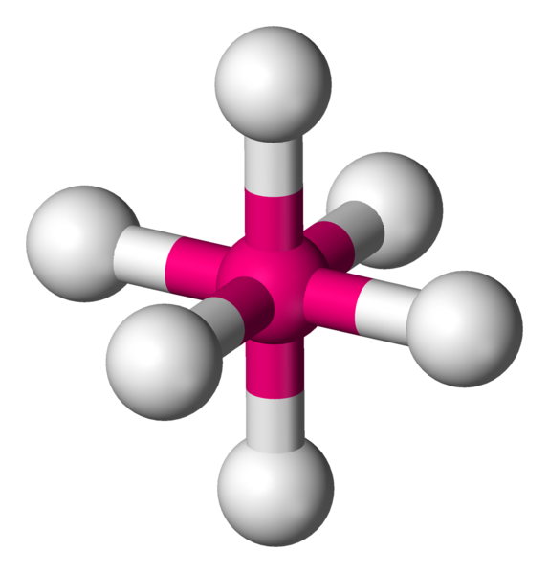
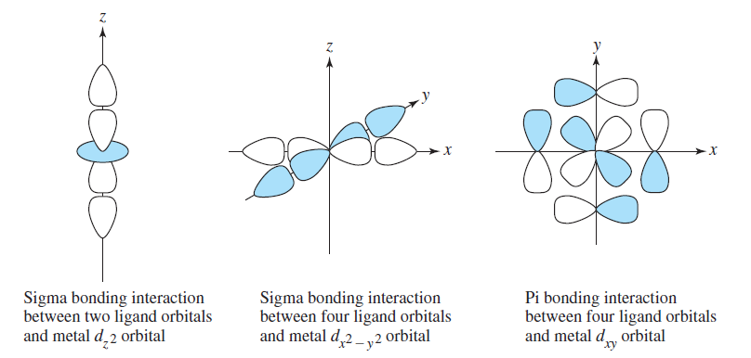
σ-MOs for Octahedral Complexes
1. Point group O_{h}
The six ligands can interact with the metal in a sigma or pi fashion. Let’s consider only sigma interactions for now.
2.
pi
sigma

Slide 8
σ-MOs for Octahedral Complexes
2.
3. Make reducible reps for sigma bond vectors
4. This reduces to:
Γ_{σ} = A_{1g} + E_{g} + T_{1u}
six GOs in total

Slide 9
σ-MOs for Octahedral Complexes
5. Find symmetry matches with central atom.
Γ_{σ} = A_{1g} + E_{g} + T_{1u}
Reading off the character table, we see that the group orbitals match the metal s orbital (A_{1g}), the metal p orbitals (T_{1u}), and the d_{z2} and d_{x2-y2} metal d orbitals (E_{g}). We expect bonding/antibonding combinations.
The remaining three metal d orbitals are T_{2g} and σ-nonbonding.

Slide 10
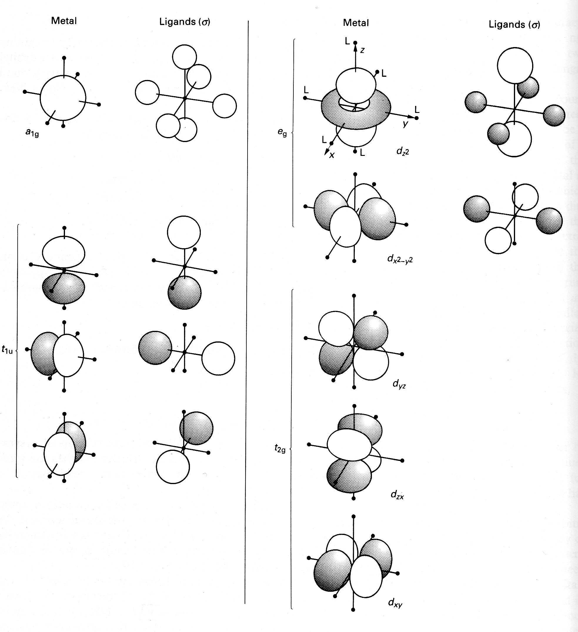
σ-MOs for Octahedral Complexes
We can use the projection operator method to deduce the shape of the ligand group orbitals, but let’s skip to the results:
L₆ SALC symmetry label
σ₁ + σ₂ + σ₃ + σ₄ + σ₅ + σ₆ A_{1g} (non-degenerate)
σ₁ - σ₃ , σ₂ - σ₄ , σ₅ - σ₆ T_{1u} (triply degenerate)
σ₁ - σ₂ + σ₃ - σ₄ , 2σ₆ + 2σ₅ - σ₁ - σ₂ - σ₃ - σ₄ E_{g} (doubly degenerate)
5
3
4
2
1
6

Slide 11
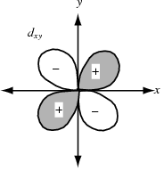
σ-MOs for Octahedral Complexes
There is no combination of ligand σ orbitals with the symmetry of the metal T_{2g} orbitals, so these do not participate in σ bonding.
L
+
T_{2g} orbitals cannot form sigma bonds with the L₆ set. S = 0.
T_{2g} are non-bonding

Slide 12
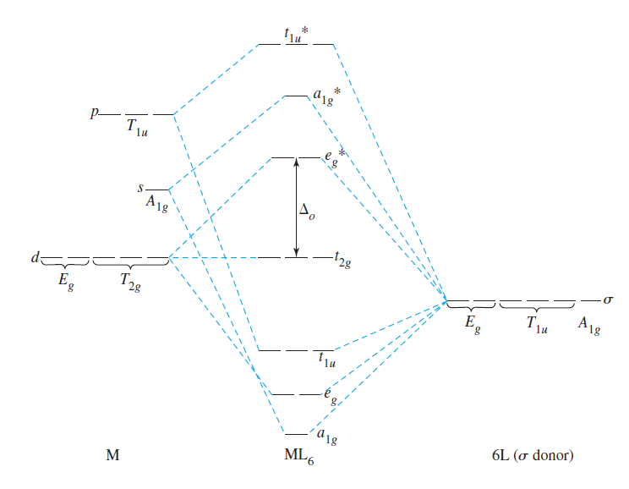
σ-MOs for Octahedral Complexes
6. Here is the general MO diagram for σ bonding in O_{h} complexes:

Slide 13
Summary
MO Theory
  MO diagrams can be built from group orbitals and central atom orbitals by considering orbital symmetries and energies.
  The symmetry of group orbitals is determined by reducing a reducible representation of the orbitals in question. This approach is used only when the group orbitals are not obvious by inspection.
  The wavefunctions of properly-formed group orbitals can be deduced using the projection operator method.
  We showed the following examples: homonuclear diatomics, HF, CO, H₃⁺, FHF⁻, CO₂, H₂O, BF₃, and σ-ML₆

