Slide 1
MO Diagrams for Diatomic Molecules
Chapter 5
Friday, October 9, 2015

Slide 2
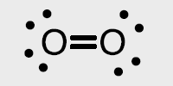






Homonuclear Diatomic Molecules
What happens when we move to more complicated systems? Consider O2.
The Lewis dot structure famously predicts the wrong electronic structure for O2
We can use LCAO-MO theory to get a better picture:
Notice that Eσ > Eπ,
because the σ bonds have more overlap than π bonds
Eσ
Eπ
2p_{a}
2p_{b}
2s_{a}
2s_{b}

Slide 3
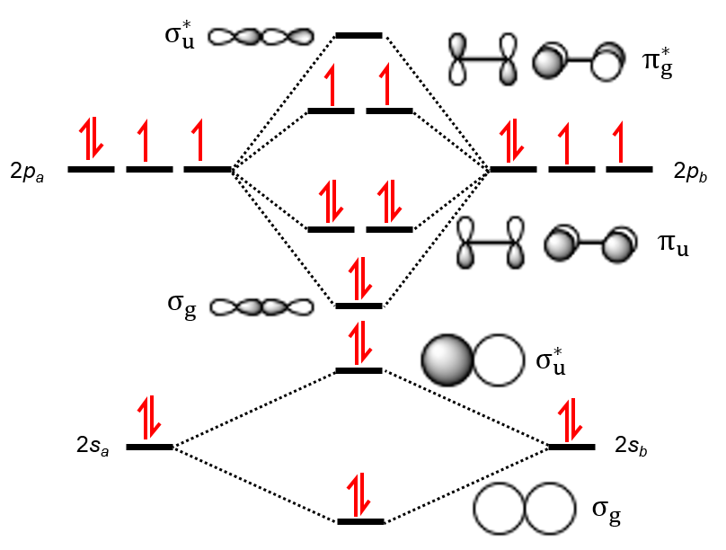
Electron Configurations and Bond Orders
Just as with atoms, we can write a molecular electron configuration for O2
σ²σ*²σ²π⁴π*²
We can also calculate the O–O bond order:
LCAO MO theory also predicts (correctly) that O2 has two unpaired electrons.

Slide 4
Orbital Mixing
Orbitals of similar but unequal energies can interact if they have the same symmetry
The 2s and 2p_{z} orbitals form MOs with the same symmetry (σ_{g} and σ_{u}). sp mixing causes the σ_{g} and σ_{u} MOs to be pushed apart in energy:
The σ and π orbitals change order!

Slide 5
Orbital Mixing
The size of the effect depends on the 2s-2p energy difference.
order changes
small Z_{eff} =
small energy difference = large sp mixing
large Z_{eff} =
large energy difference = small sp mixing

Slide 6
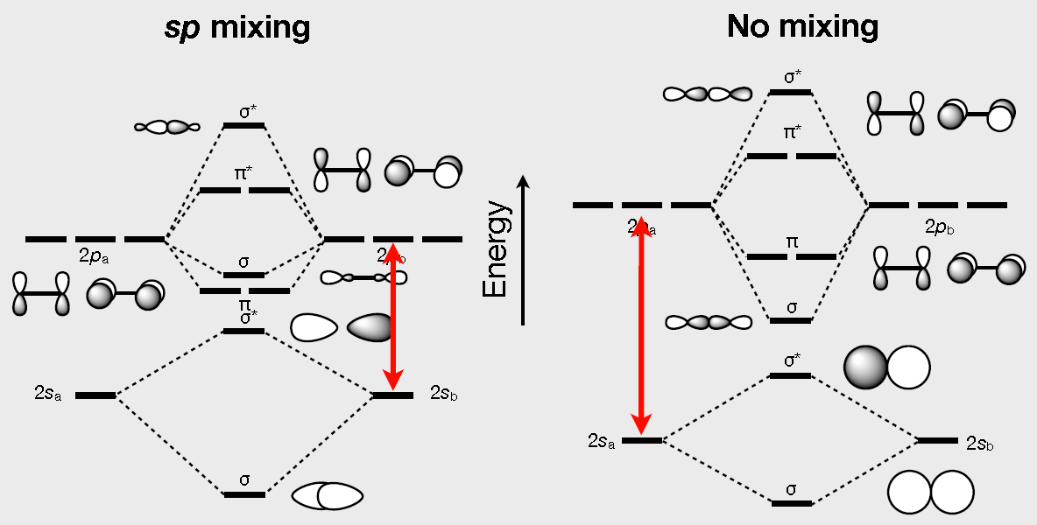
MOs of Homonuclear Diatomic Molecules
The MO picture of homonuclear diatomic molecules depends on the amount of sp mixing.
Li₂, Be₂, B₂, C₂, N₂
O₂, F₂, Ne₂

Slide 7
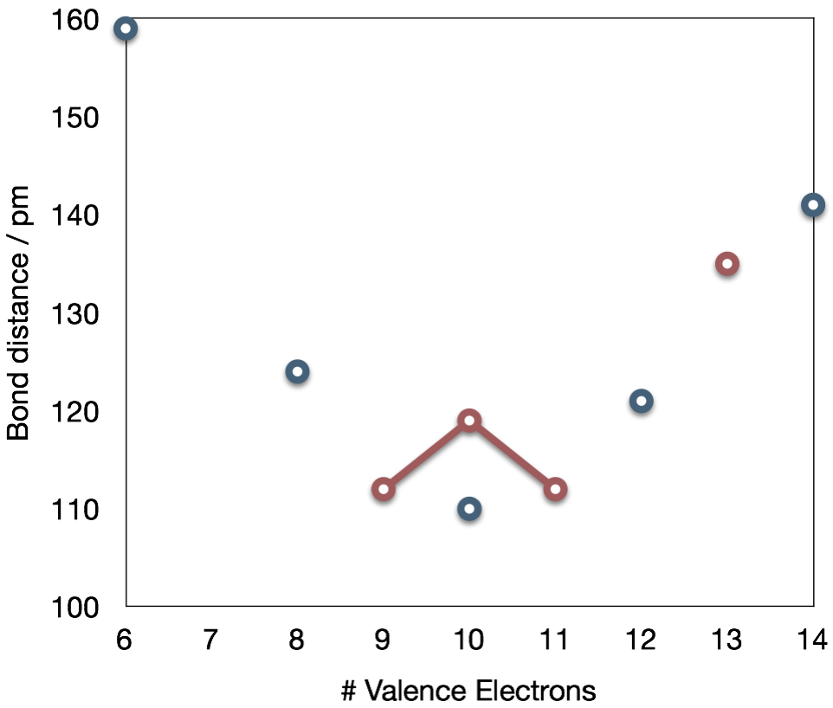
Bond Order and Bond Distance
The MO bond order is the main factor controlling the internucelar distance.
B2
σ²σ*²π²
BO = 1
F2
σ²σ*²σ²π⁴π*⁴
BO = 1
O2–
σ²σ*²σ²π⁴π*³
BO = 1.5
C2
σ²σ*²π⁴
BO = 2
C2^{2–}
σ²σ*²π⁴σ²
BO = 3
O2
σ²σ*²σ²π⁴π*²
BO = 2
N2⁺
σ²σ*²π⁴σ¹
BO = 2.5
O2⁺
σ²σ*²σ²π⁴π*¹
BO = 2.5
N2
σ²σ*²π⁴σ²
BO = 3

Slide 8
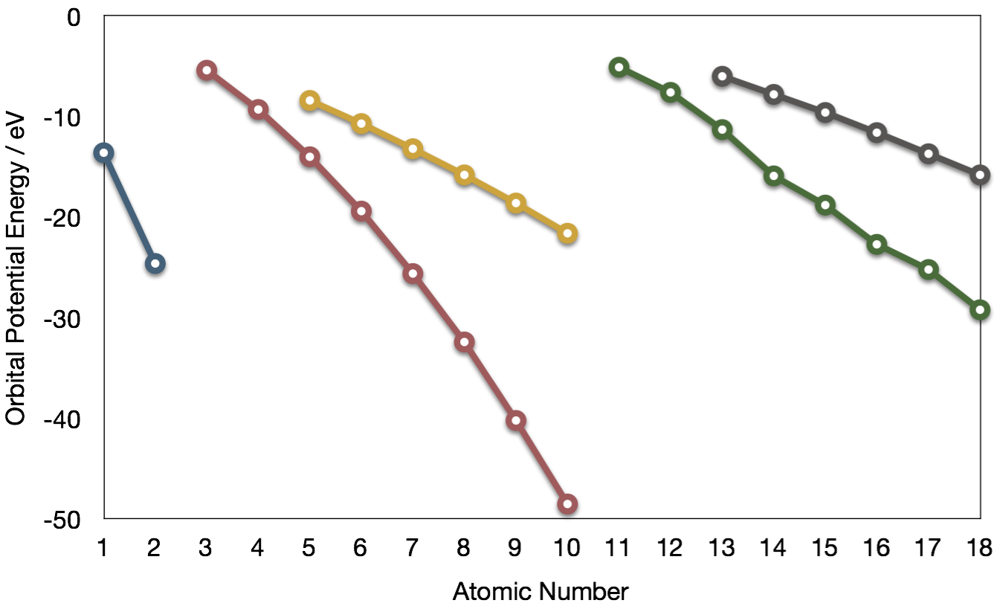
Relative AO Energies for MO Diagrams
Photoelectron spectroscopy gives us a pretty good idea of the relative energies for AOs.
Al
B
Si
Li
C
Na
P
Mg
S
H
Be
N
3p
Cl
–13.6 eV
Al
Ar
B
O
3s
2p
F
Si
1s
–18.6 eV
C
2s
Ne
P
He
S
N
Cl
Ar
O
F
–40.2 eV
Ne

Slide 9
MO Diagram for HF
The AO energies suggest that the 1s orbital of hydrogen interacts mostly with a 2p orbital of fluorine. The F 2s is nonbonding.
σ*
–13.6 eV
1s
–18.6 eV
nb
2p
Energy
σ
So H–F has one σ bond and three lone electron pairs on fluorine
–40.2 eV
nb
2s
H
H–F
F

Slide 10
Relative AO Energies for MO Diagrams
Photoelectron spectroscopy gives us a pretty good idea of the relative energies for AOs.
Al
B
Si
Li
C
Na
P
–10.7 eV
Mg
S
H
Be
N
3p
Cl
Al
Ar
B
O
–15.8 eV
3s
2p
F
Si
1s
–19.4 eV
C
2s
Ne
P
He
S
N
Cl
Ar
–32.4 eV
O
F
Ne

Slide 11
Heteronuclear Diatomic Molecules: CO
In molecules with more than one type of atom, MOs are formed from AOs that have different energies. Consider CO:
σ*
LUMO is on carbon too!
π*
HOMO is on carbon
2pa
Energy
σ
2pb
π
σ*
Anti-bonding orbitals get polarized towards carbon
2sa
2sb
Bonding orbitals get polarized towards oxygen
σ
C
C≡O
O

Slide 12
Summary
MO Theory
LCAO-MO Theory is a simple method for predicting the approximate electronic structure of molecules.
Atomic orbitals must have the proper symmetry and energy to interact and form molecular orbitals.
Photoelectron spectroscopy provides useful information on the energies of atomic orbitals.
Next we’ll see that symmetry will help us treat larger molecules in the LCAO-MO theory framework.

